Slide 1
Introduction to SQL
Structured Query Language

Slide 2
Topics
1. Filtering Functions
2. Filtering for Data with Multiple Conditions
3. Filtering for Data Between a Range of Values
4. Regular Expressions and String Pattern Detection
5. Setting Condition with Cases
6. Introducing Subqueries

Slide 3
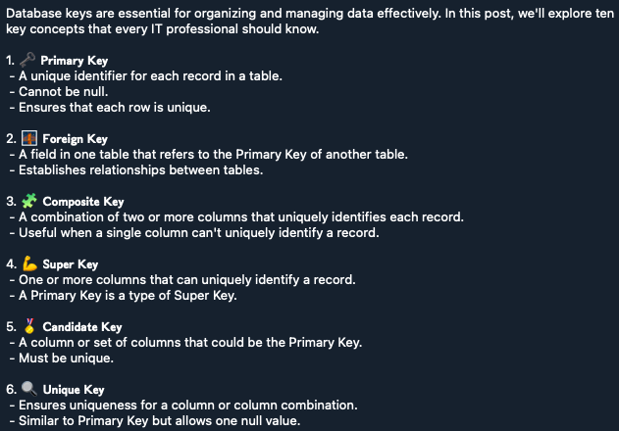
Terminologies

Slide 4
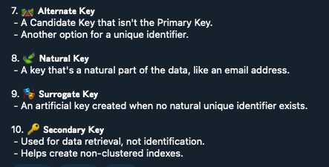

Slide 5
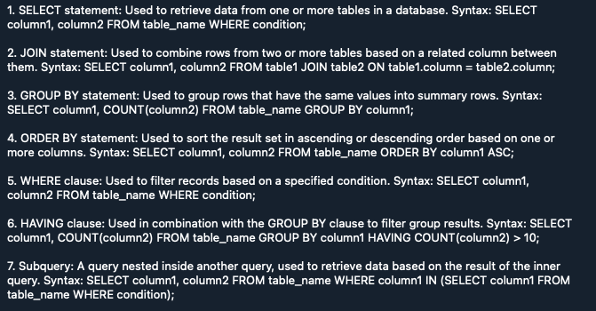
Important Clauses

Slide 6
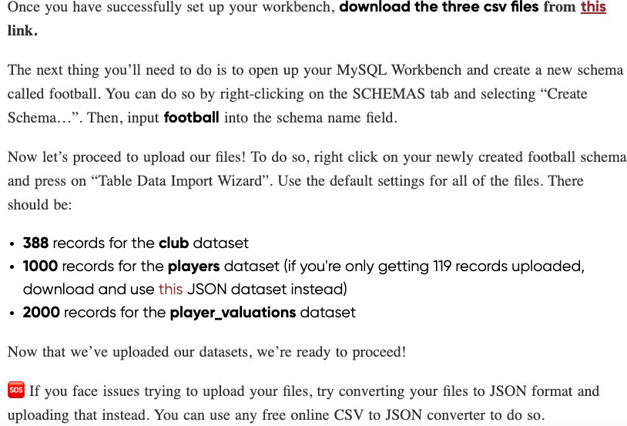
Lab Session

Slide 7
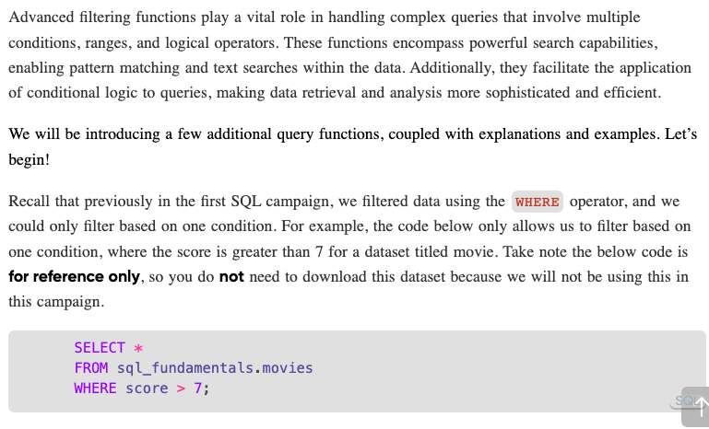

Slide 8
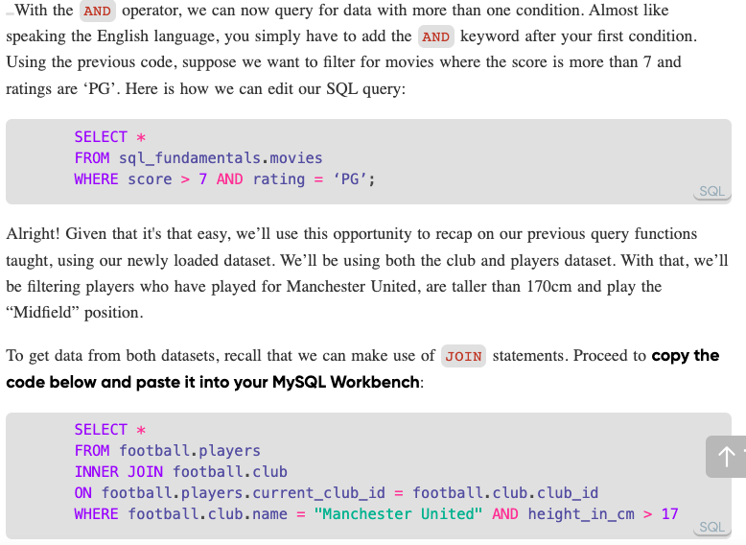

Slide 9
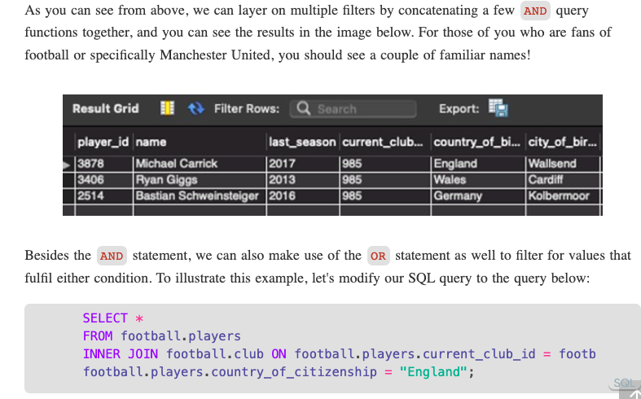

Slide 10
